Slide 1

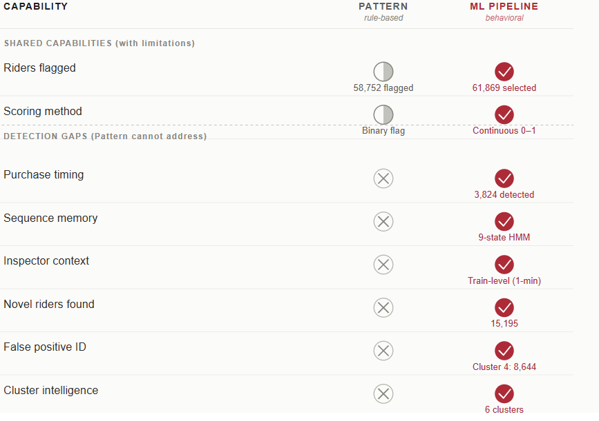
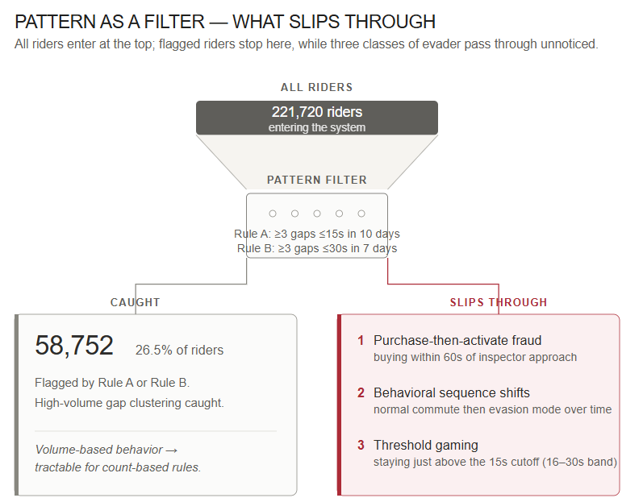
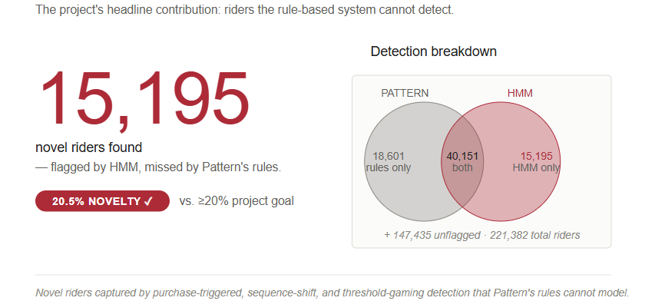
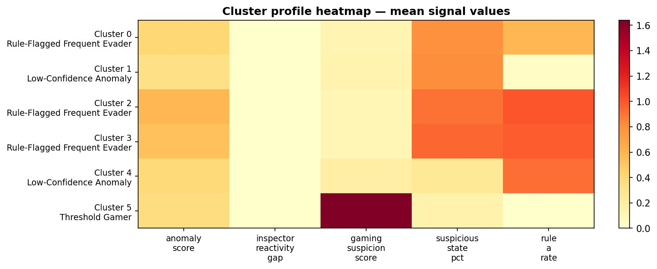
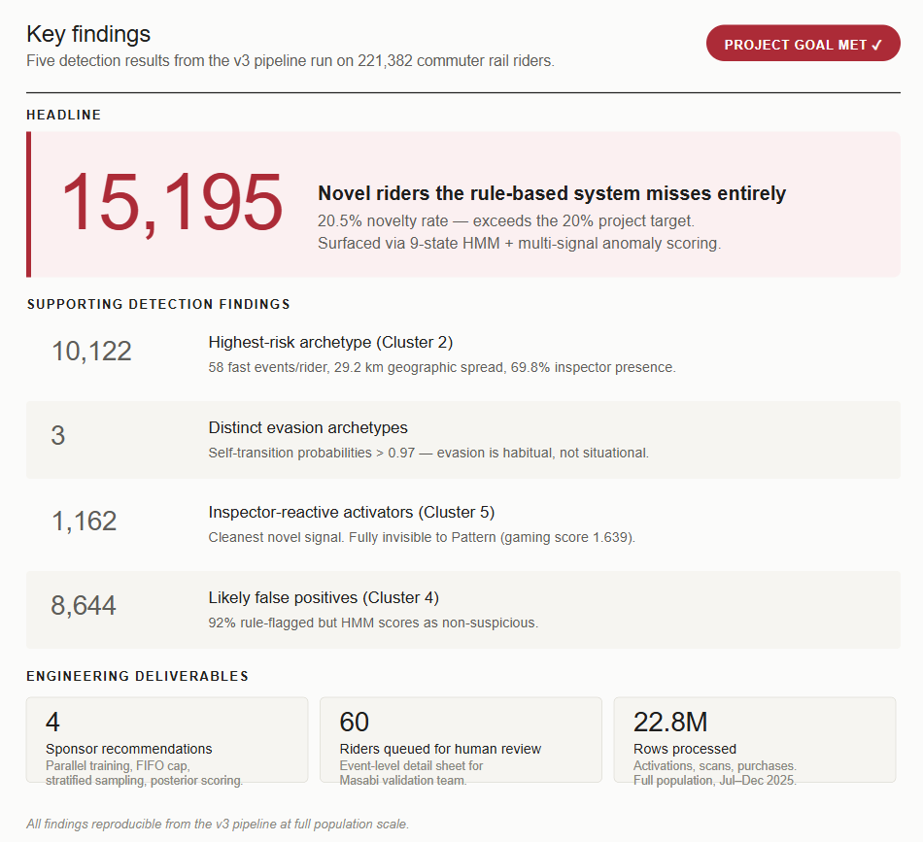
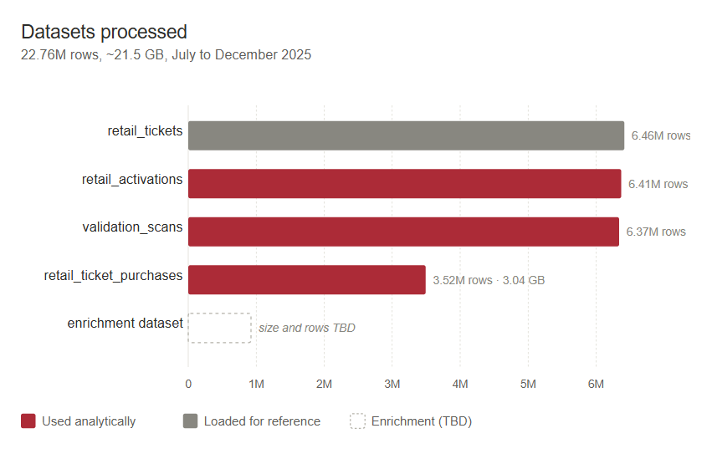
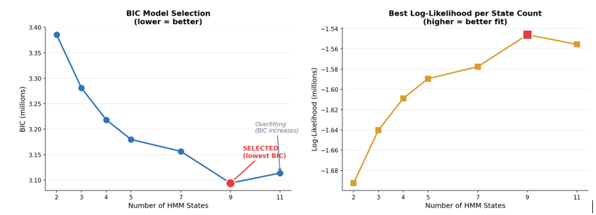
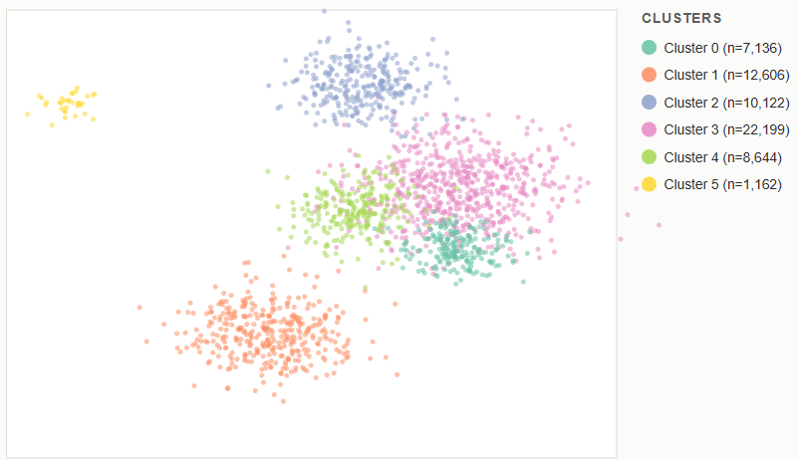
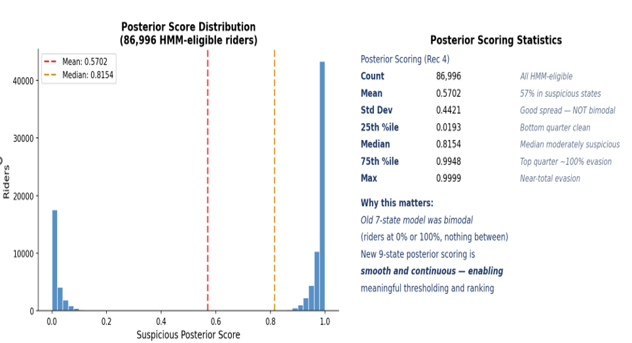
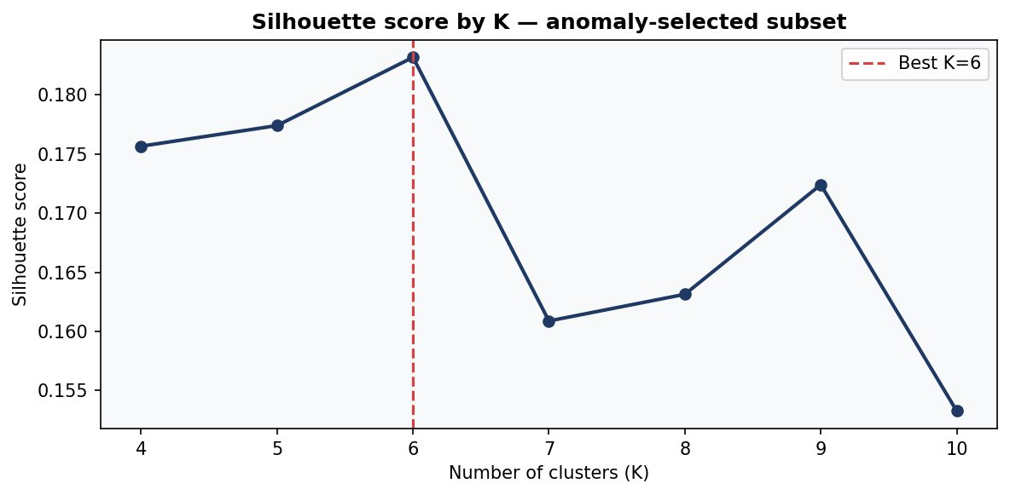
INSPECTOR-TRIGGERED TICKET PURCHASE FRAUD DETECTION
Detecting Fare Evasion Using Hidden Markov Models and Multi-Signal Anomaly Scoring
PRESENTED BY: DANIEL DUAH · BISMARK KOFI OWUSU SARFO · SAI PRIYA MALYALA · MARTIN THULANI MILANZI · SAI KRISHNA VADDEBOINA
WPI Capstone Project | Fintech Team 2 | Spring 2026
15,195
40,151
18,601
1,162
6
221,720
novel riders
HMM + Rules both
Rules only
inspector-reactive
cluster archetypes
riders entering the system
20.5% novelty
confirmed evaders
HMM disagrees
C5 · gaming 1.639
K=6 (silhouette 0.183)
01
INTRODUCTION
06
HMM — 3 EVASION ARCHETYPES
08
SIX EVASION CLUSTERS (K=6)
10
PATTERN VS OUR PIPELINE
A fraud pattern has emerged on MBTA commuter rail: riders activate tickets only when they spot an inspector, making purchase, activation, and scan look identical to legitimate use. Pattern's count-based rules catch 58,752 such riders, but miss those who buy reactively, game the thresholds, or shift behavior over time. This project's HMM-based pipeline surfaces 15,195 evaders Pattern misses entirely.
BIC selected 9 states from [2,3,4,5,7,9,11] | 70 fits | 11.4 hrs | 65,376 riders (50/50 stratified)
C0
Rule-Flagged Evader
7,136
Capability
Pattern Rules
ML Pipeline
State
Habitual Evader
20,075 riders
Score: 0.416 | Rule A: 58.9%
1
ACTIVATE_FAST_HANDHELD (75.3%)
Self-transition: 0.984 — once in this state, riders almost never leave
Peak-hour evasion (58.3% peak fast ratio)
02
C1
HMM-Novel Anomaly
12,606
Score: 0.331 | Rule A: 3.1%
0
Purchase-Triggered
11,920 riders
83.9% are novel riders — primary validation target
02
THE PROBLEM
PURCHASE_THEN_ACTIVATE_FAST (36.7%)
Self-transition: 0.971 — once in this state, riders almost never leave
C2
Confirmed Evader
10,122
Score: 0.585 | Rule A: 100%
State
58 fast events avg, 162-day span, 29.2 km spread
C3
Large Evader Pool
22,199
3
State
Moderate Evader
20,099 riders
Score: 0.534 | Rule A: 97.6%
THE PROBLEM
ACTIVATE_FAST_HANDHELD (46.3%)
Self-transition: 0.973 — once in this state, riders almost never leave
Largest cluster, highest susp_pct (0.942)
C4
HMM-Discordant
8,644
Score: 0.399 | Rule A: 92.2%
Possible false positives (117s mean gap, 0.249 susp)
C5
Inspector-Reactive
1,162
07
HMM NOVELTY — WHAT PATTERN MISSES
Score: 0.365 | Rule A: 0.1%
Gaming score 1.639, invisible to Pattern
K-6 CLUSTER GRAPH & UMAP
09
11
WHAT WE FOUND
03
OBJECTIVE
To build a proof-of-concept HMM pipeline that detects three evasion patterns Pattern misses: purchase-triggered, sequence-persistent, and inspector-reactive with at least 20% of flagged riders being net-new
04
DATASETS
Heatmap rows = clusters C0–C5; columns = mean signal values. C5 gaming score (1.639) is 10× any other cluster — invisible to Pattern.
BAYESIAN INFORMATION CRITERION MODEL SELECTION
Six behavioral signatures among anomalous riders
0
12
CONCLUSION & RECOMMENDATIONS
The ML pipeline extends the Pattern. It does not replace it. Pattern's rules remain 20% of the composite score and provide strong baseline confirmation. The pipeline adds three capabilities Pattern structurally lacks: sequence memory, inspector context, and continuous risk scoring.
C2
IMMEDIATE ACTION
05
SCORING PIPELINE
POSTERIOR DOMINANCE SCORING
Deploy targeted inspection on high-density routes
Four normalised signals weighted into a composite anomaly score (0–1):
C1
Human Validation
30%
Inspector Reactivity
Validate 83.9% novel population — genuine evaders or false positives?
25%
Faster when inspector is on the commuter train?
C0
PEAK ENFORCEMENT
25%
HMM Posterior Score
Focus inspectors on peak-hour commuter trains
Fraction of sequence in evasion states (0, 1, 3)?
C5
MONITOR
25%
Gaming Suspicion
Inspector-reactive activators — invisible to Pattern
Activations cluster in 16–30s range upon seeing inspector?
20%
Rule Flag Score
C4
INVESTIGATE
Pattern HIGH / MEDIUM confirmation?
Possible false positives — Pattern may be over-flagging
Score = 0.30·Inspector + 0.25·HMM + 0.25·Gaming + 0.20·Rules
THANK YOU, PROFESSOR JIM RYAN

